Slide 1
Exploring Different Modes of Operation of Block Ciphers
Presented By:
M.Hasebur Rahman Sinha
BSSE-1620
Supervisor:
Prof. Dr. Shariful Islam

Slide 2
Problem Statement and Objectives
Security depends on how mathematically secure ciphers are used
# Block ciphers encrypt fixed-size blocks, but real world data is variable
# Incorrect mode usage leads to
Pattern Leakage
Replay Vulnerability
Inefficiency
My project is an educational toolkit that emphasizes correct cryptographic usage and mathematics behind ideas, not just algorithms.

Slide 3
Block Cipher
A Block Cipher is an encryption algorithm that takes a fixed-size input (say , b bits) and produces a ciphertext of b bits.
Some Block Ciphers I used,
# DES (64-bit block, legacy)
# 2DES (cumulative DES, did not improve DES)
# 3DES (security extension of DES)
# AES (modern standard)
Modes of Operation define how blocks are chained together

Slide 4
Modes of Operation
# ECB (Electronic CodeBook) – simplest, insecure, padding needed
# CBC (Cipher Block Chaining)– Sequential. Padding needed, IV needed
#CFB (Cipher FeedBack) – Stream-like behavior, Bit by Bit
#OFB (Output FeedBack) – Keystream-based, No padding

Slide 5
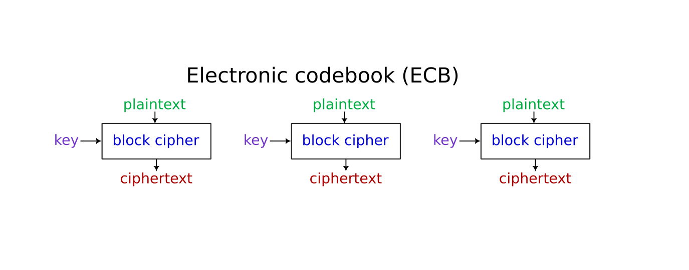
ECB (Electronic CodeBook)
Properties:
# Encrypted Using Same Key
# Each block Independently Encoded
Pros:
# Simple
# Parallel Processing Possible (Fast)
Cons:
# Not Secure For length messages
# Pattern Leak (DEMO 1)
# Known-Plaintext Attack

Slide 6


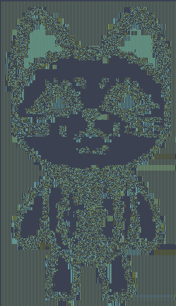

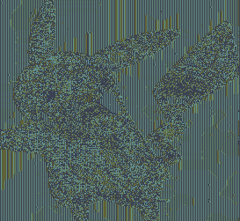

Pattern Leak

Slide 7
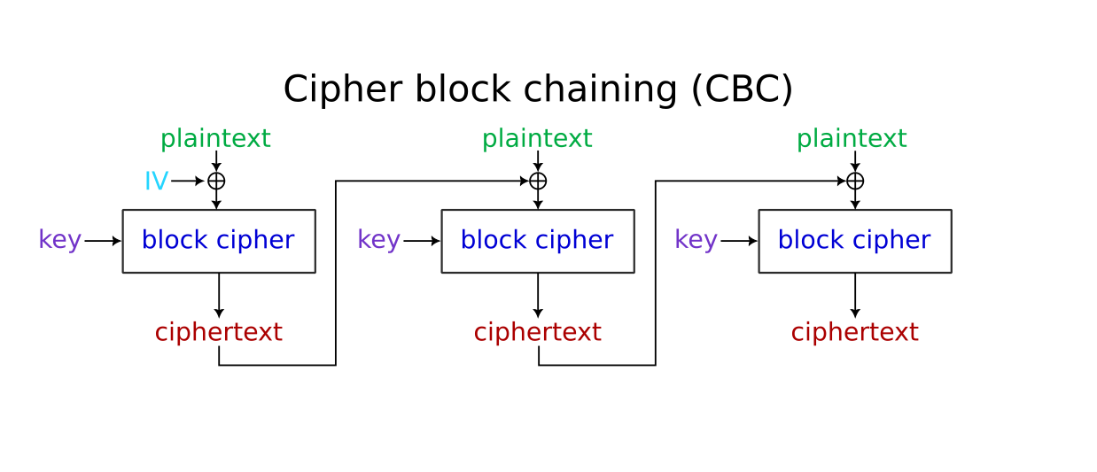
CBC (Cipher Block Chaining)
Properties:
# Initialization Vector
# Dependent Blocks
Pros:
# Hide Pattern
# Error effect that block and the next one
Cons:
# Requires Padding
# Parallel processing not possible (Slow)
# Incorrect Padding may lead to vulnerabilities

Slide 8
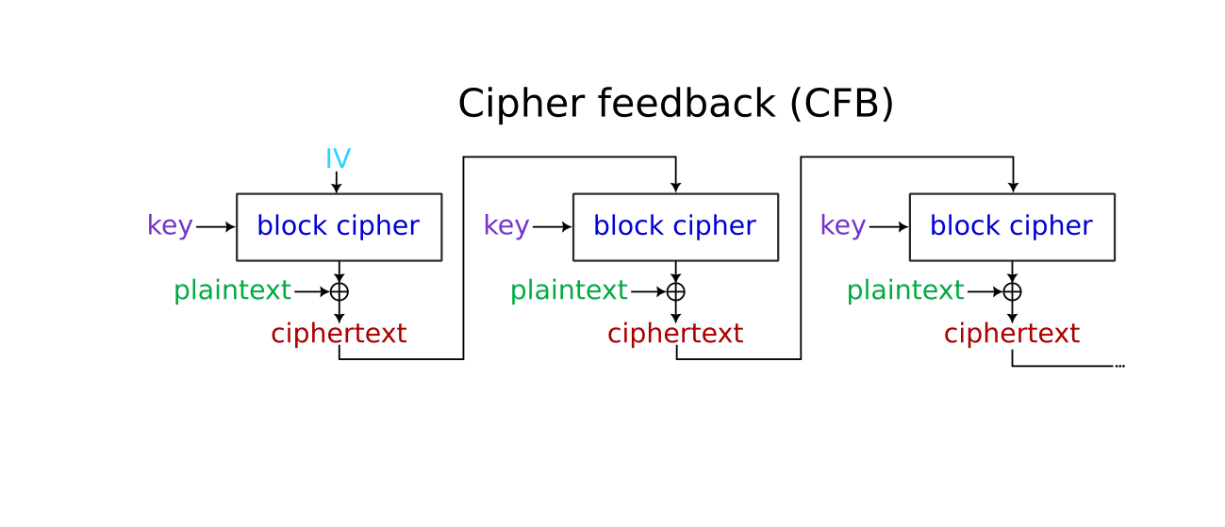
CFB (Cipher FeedBack)
Properties:
# Like Stream- Cipher
# Uses IV
Pros:
# No padding needed # Good for streaming data
# Self Synchronizing
Cons:
# Slower, not parallelizable
# No authentication
# More Error Propagation

Slide 9
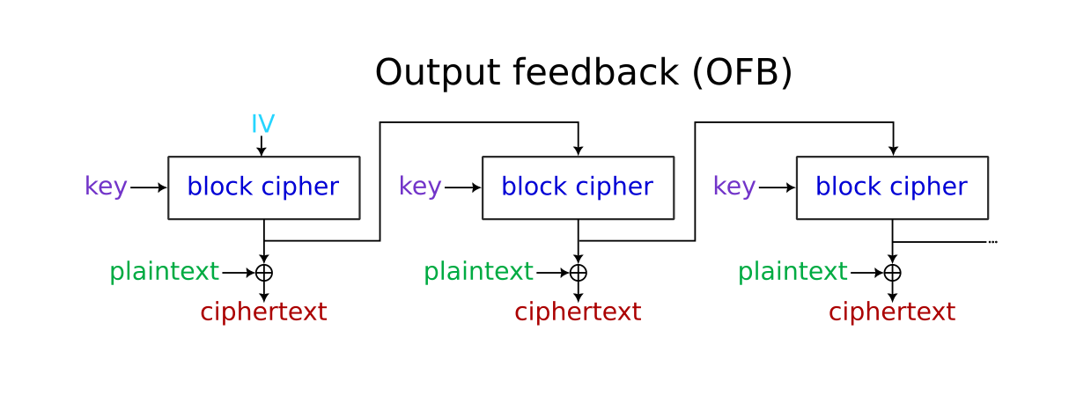
OFB (Output FeedBack)
Pros:
# No padding needed # Good for streaming data
# Self Synchronizing
Properties:
# Like Stream- Cipher
# Uses IV , no padding
# Keystream independent of plaintext/ciphertext
Pros:
# No padding needed # No error Propagation
# Keystream pre-computable
Cons:
# Not Self-synchronizing
# No Authentication

Slide 10
DES Known Plaintext Attack
DES has a keyspace of 2⁵⁶ which is possible to brute force with modern computers. If we can guess the plaintext of 1 block, we can use plaintext attack. Other bruteforce is also possible in about 3 hours. So DES can be broken. For demonstration of this attack we may decrease the key space Say,
(0/1) (0/1) (0/1) (0/1).. X times | 0 0 0 … 64-X times
Here, we only need to guess the first X bits, others are 0. So we can simulate this attack without changing algorithm. (DEMO)

Slide 11
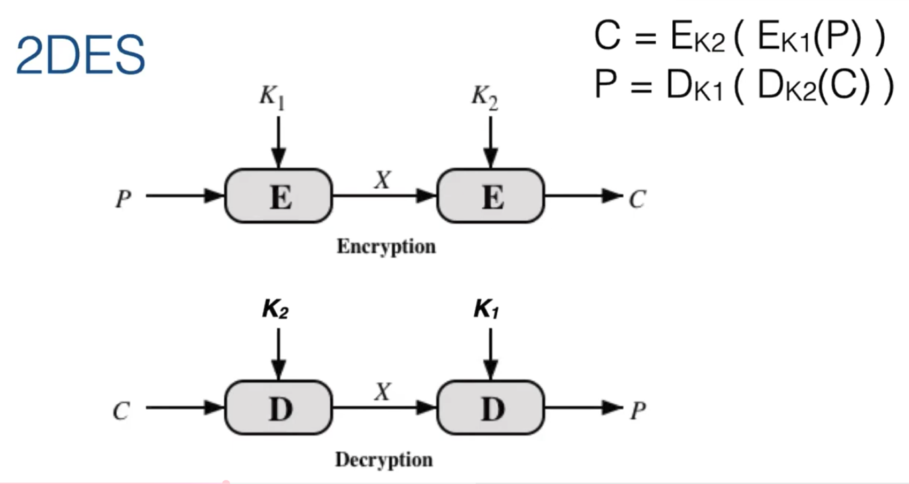
2DES (Double DES)
With 2 DES arranged like this, we get a supposed keyspace of 2¹¹² making it mathematically secure. However, using meet in the middle attack, we can do it in 2⁵⁶ . (DEMO)
Main vulnerability is that the middle part X is same in both cases

Slide 12
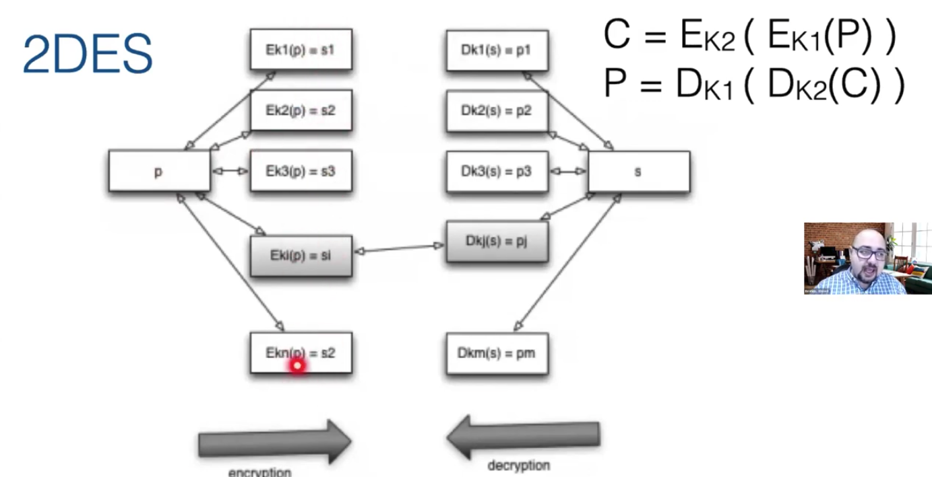
MITM (Meet in the Middle Attack)
Attacker computes E_{k1} (P)
and D_{k2} (C) matching to find both the keys in complexity 2⁵⁷ and not 2¹¹²
3DES was thus introduced as a safe alternative which has a keyspace of 2¹⁶⁸

Slide 13
Thank You!
This project has been a very good learning experience in security, design and understanding how small decisions can have significant effects. I have learned a great deal and look forward to implementing improvements in the future.

